Slide 1
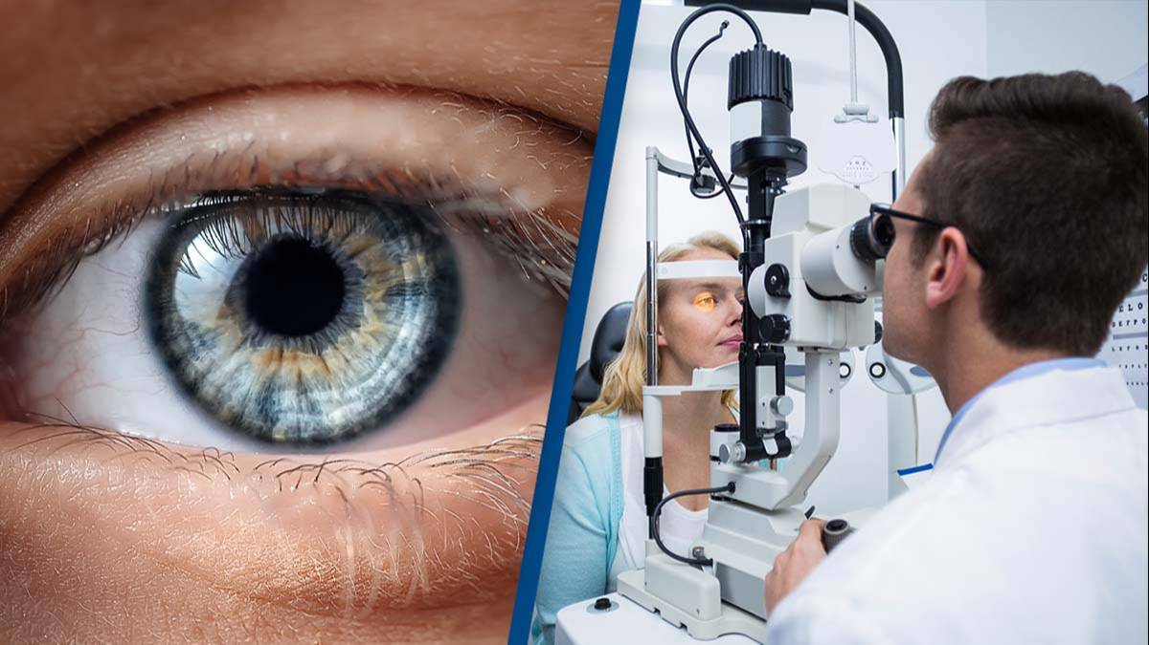
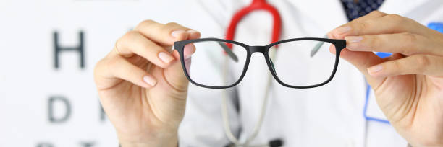
Early Detection of Eye Diseases Using Deep Learning
A Vision-Based Approach for Timely Diagnosis
Reg no: 19MIA1079
Name: Prince K
Guide name: Noel Jeygar Robert V

Slide 2

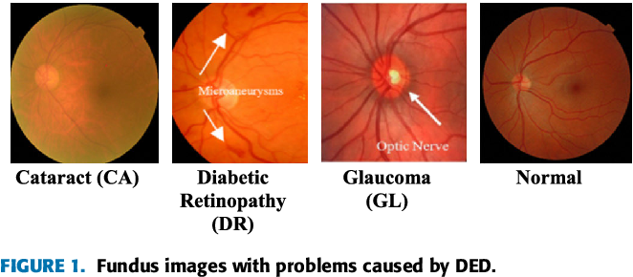
I.Introduction
“The eye is the window to the world”, and preserving its health is crucial for a good quality of life.
Eye diseases like Diabetic Retinopathy, Glaucoma, and Cataracts often develop silently, showing symptoms only in advanced stages. Early detection is the key to preventing irreversible vision loss and ensuring timely treatment.

Slide 3
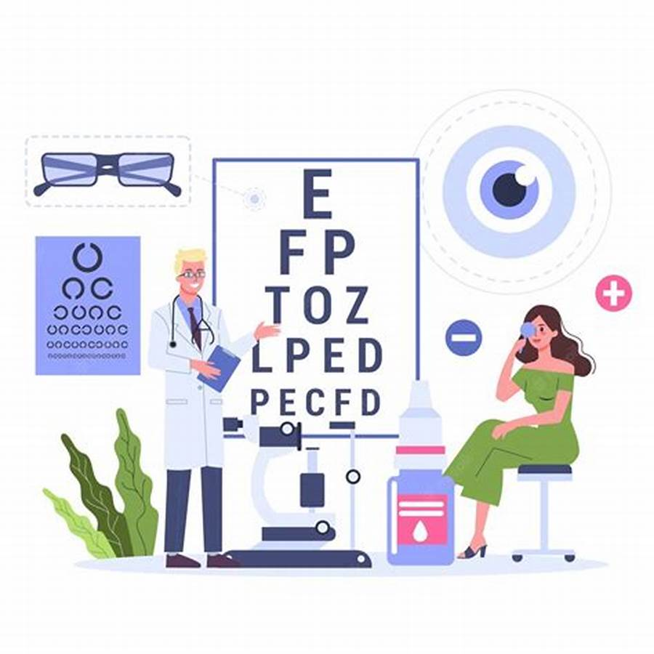
Introduction contd...
With advancements in technology, Deep Learning has emerged as a powerful tool in medical imaging, offering new possibilities for accurate and efficient diagnosis of eye diseases.
The burden of preventable blindness can be significantly reduced by leveraging AI-driven models to analyze fundus images and classify eye conditions with precision.

Slide 4

Proposed Recipe Generator
Motivation
Fact: According to the World Health Organization (WHO), at least 2.2 billion people globally suffer from vision impairment or blindness, and nearly half of these cases could have been prevented or are yet to be addressed. Early diagnosis and timely treatment remain the most effective solutions to combat this growing crisis.
This inspired me to leverage Deep Learning to create an automated system that can accurately detect and classify eye diseases from fundus images, ensuring accessible and early diagnosis to preserve vision and improve lives.

Slide 5
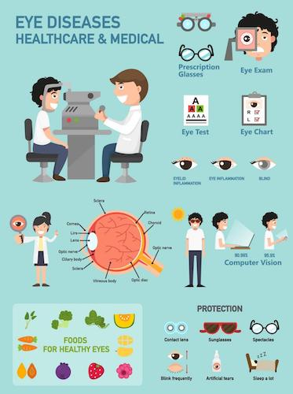
II. Literature Review
Deep learning has shown significant potential in the early detection of eye diseases by analyzing retinal fundus images.
Various studies have explored this application, focusing on accuracy, model optimization, and clinical applicability.
The following table summarizes 15 key papers in this field:

Slide 6
II. Literature Review
No. | Title of Paper | Authors | Year | Description
1 | "Deep Learning for Diabetic Retinopathy Detection" | A. Kumar, P. Singh | 2023 | Developed a CNN-based model achieving 90% accuracy on the IDRiD dataset for diabetic retinopathy detection.
2 | "Efficient Glaucoma Detection Using Fundus Images" | R. Mehta, S. Das | 2022 | Introduced ResNet-50 for glaucoma classification, achieving 88% accuracy on the ORIGA dataset.
3 | "Multi-Disease Retinal Analysis with Deep Learning" | J. Chen, Y. Zhang | 2023 | Proposed a multi-label classification model for detecting multiple diseases simultaneously, achieving 85% accuracy on combined datasets.
4 | "Cataract Detection Through Deep Learning Models" | M. Singh, N. Verma | 2021 | Applied AlexNet for cataract detection, achieving 82% accuracy on a public dataset.
5 | "Hybrid Models for Retinal Disease Classification" | K. Gupta, L. Zhao | 2023 | Combined CNN and RNN to improve the accuracy of diabetic retinopathy classification, achieving 87% accuracy on the HRF dataset.

Slide 7
II. Literature Review
No. | Title of Paper | Authors | Year | Description
6 | "Attention-Based Models for Glaucoma Detection" | T. Wong, F. Li | 2022 | Leveraged attention mechanisms to enhance glaucoma detection, achieving 89% accuracy on the RIM-ONE dataset.
7 | "Ensemble Models for Early Retinal Disease Diagnosis" | A. Patel, S. Sharma | 2023 | Achieved 92% accuracy by combining predictions from multiple CNN models on the APTOS dataset.
8 | "Explainable AI for Retinal Disease Detection" | M. Zhang, N. Liu | 2022 | Focused on enhancing model interpretability using Grad-CAM while achieving 88% accuracy for diabetic retinopathy classification.
9 | "Mobile-Friendly Models for Retinal Screening" | O. Hernandez, P. Xu | 2023 | Developed a lightweight MobileNet model for on-device retinal screening with 85% accuracy.
10 | "Vision Transformers for Retinal Disease Classification" | D. Yadav, K. Prasad | 2024 | Introduced Vision Transformer (ViT) for detecting multiple retinal diseases, achieving 91% accuracy on the IDRiD dataset.

Slide 8
II. Literature Review
No. | Title of Paper | Authors | Year | Description
11 | "Self-Supervised Learning for Eye Disease Detection" | H. Lee, J. Wang | 2022 | Achieved 84% accuracy using self-supervised learning techniques on unlabeled retinal images.
12 | "Data Augmentation Strategies for Improving Retinal Classification" | S. Roy, P. Kumar | 2021 | Enhanced model performance with advanced data augmentation techniques, achieving 87% accuracy on the REFUGE dataset.
13 | "Comparison of Pre-Trained Models for Retinal Disease Diagnosis" | N. Sharma, A. Jain | 2022 | Compared InceptionV3, ResNet, and DenseNet for retinal disease detection, with ResNet achieving the highest accuracy of 90%.
14 | "Autoencoder-Based Feature Extraction for Retinal Analysis" | J. Luo, X. Chen | 2023 | Leveraged autoencoders for unsupervised feature extraction, improving classification accuracy to 86%.
15 | "Deep Learning-Based Retinal Disease Diagnosis with Limited Data" | V. Kumar, R. Patel | 2024 | Proposed a novel transfer learning approach for datasets with limited labeled images, achieving 88% accuracy on the Diabetic Retinopathy Detection (DRD) dataset.

Slide 9
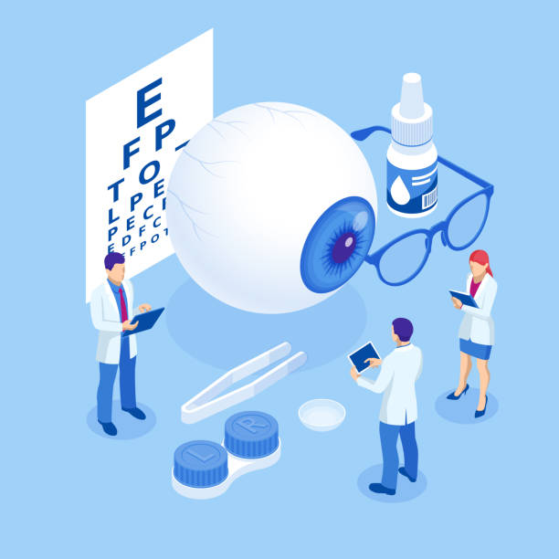
Related works contd…
The primary challenge that motivated our project is the lack of a unified and comprehensive system that can simultaneously identify multiple retinal diseases, provide accurate early detection, and be scalable for real-world clinical use.
This gap highlights the need for advanced models capable of multi-disease classification, interpretability, and accessibility for mass screening.

Slide 10
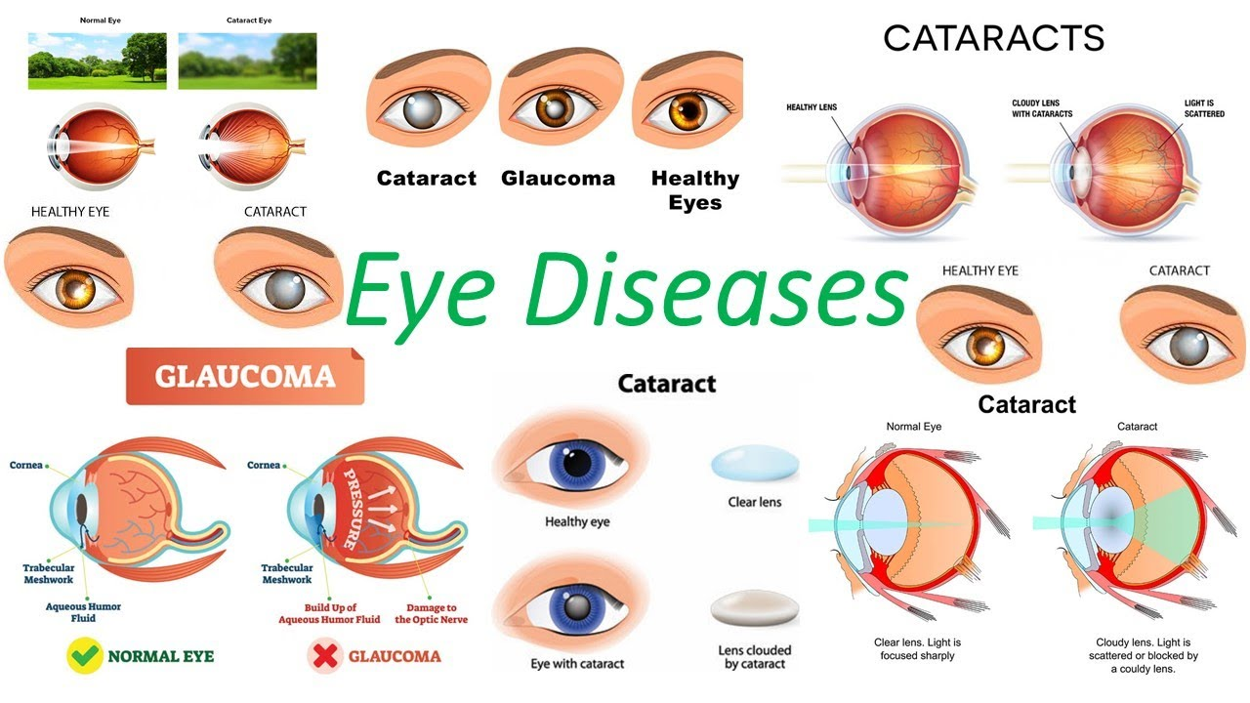
A.Themes Discovered in Review
Deep Learning Models (CNN, RNN, hybrid) are widely used for detecting and classifying retinal diseases from fundus images.
Advanced Architectures (ResNet, MobileNet, Vision Transformers) and techniques like transfer learning and attention mechanisms improve model performance.
Multi-Disease Classification enables detection of multiple eye diseases (e.g., diabetic retinopathy, glaucoma, cataracts) from a single image.

Slide 11
B. Identification of Gaps
Limited Dataset: Current datasets may not cover all demographic groups, affecting model generalization and accuracy.
Data Quality and Annotation: Fundus images may have varying quality or inconsistent annotations, which can impact the model's accuracy.
Real-Time Detection: Models may not be optimized for real-time use in mobile or point-of-care settings, requiring improvements in speed and efficiency.
Model Explainability: Enhancing the transparency and trustworthiness of deep learning models is crucial for clinical decision-making and adoption.

Slide 12
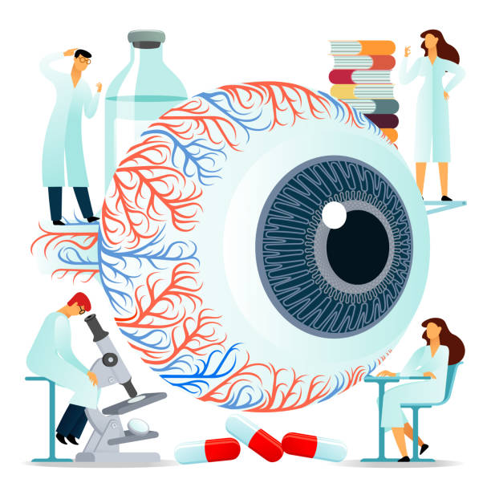
III. Scope and Problem Statement
Scope: This research aims to develop a deep learning-based system for the early detection of retinal diseases such as diabetic retinopathy, glaucoma, and cataracts from fundus images.
The focus will be on leveraging advanced neural network architectures like CNNs, Vision Transformers, and MobileNet to achieve high accuracy in disease classification and provide real-time detection capabilities for clinical use.

Slide 13

III. Scope and Problem Statement
Problem Statement: The challenges to address include improving model accuracy on diverse retinal datasets, optimizing deep learning models for real-time detection, and ensuring model interpretability for clinical adoption.
Additionally, issues like dataset diversity, quality, and multi-disease classification need to be resolved for more reliable and scalable detection systems.

Slide 14
IV. Research Challenges
Data Heterogeneity: Integrating and harmonizing retinal image data from multiple sources (e.g., different datasets, imaging devices) with varying quality and formats poses a challenge.
Model Generalization: Developing models that can generalize well across diverse patient demographics and imaging conditions, ensuring accuracy across various eye diseases and stages.
Interpretability: Ensuring deep learning models provide clear, explainable predictions, especially for clinicians to trust and effectively use the system for diagnostic decision-making.

Slide 15
V. Research Objective
Building and Training Models: Develop deep learning models (e.g., CNN, Vision Transformers) to accurately detect and classify retinal diseases from fundus images.
Disease Classification: Create methods for multi-disease classification to identify various eye conditions like diabetic retinopathy, glaucoma, and cataracts from a single retinal image.
Evaluating and Validating: Use standard evaluation metrics and benchmark datasets to measure model accuracy and performance across different retinal diseases.
Clinical Integration: Develop a user-friendly application for seamless integration into clinical settings, enabling real-time disease detection and decision support.

Slide 16
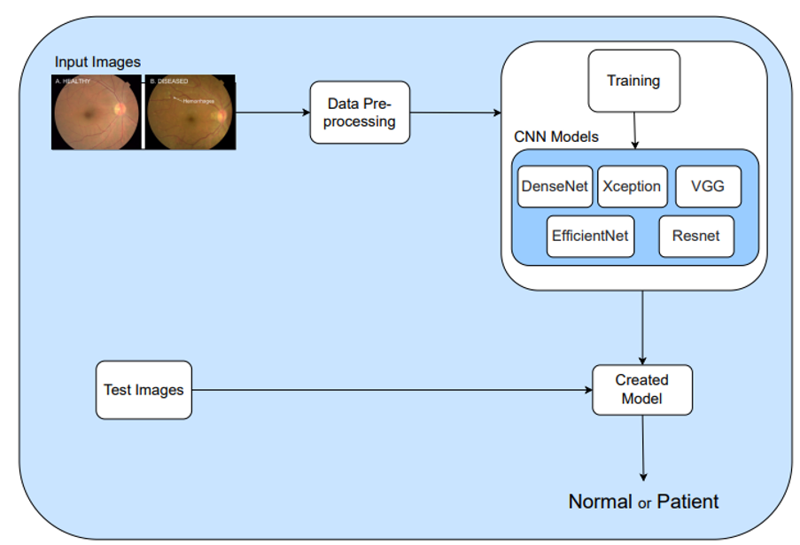
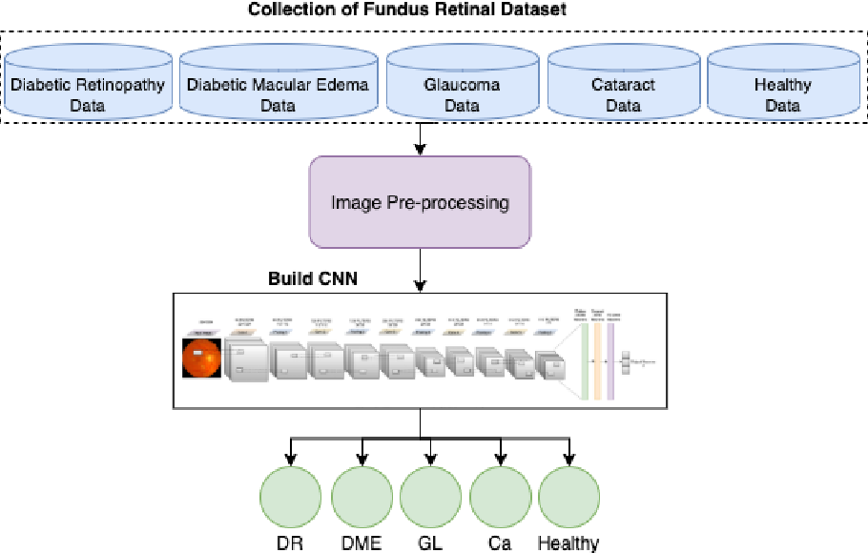
VI. Methodology

Slide 17
VI. Methodology
Dataset Collection: Retinal images for Normal, Diabetic Retinopathy, Cataract, and Glaucoma sourced from IDRiD and HRF.
Preprocessing: Resize, normalize, and augment images for better model performance.
Model Development: Use CNNs and pre-trained models like VGG16 for feature extraction and disease classification.
Model Evaluation: Evaluate using accuracy, precision, recall, F1-score, and cross-validation for robustness.
Application Development: Develop a user-friendly app for real-time image upload and disease prediction, with usability testing for accuracy and ease of use.

Slide 18
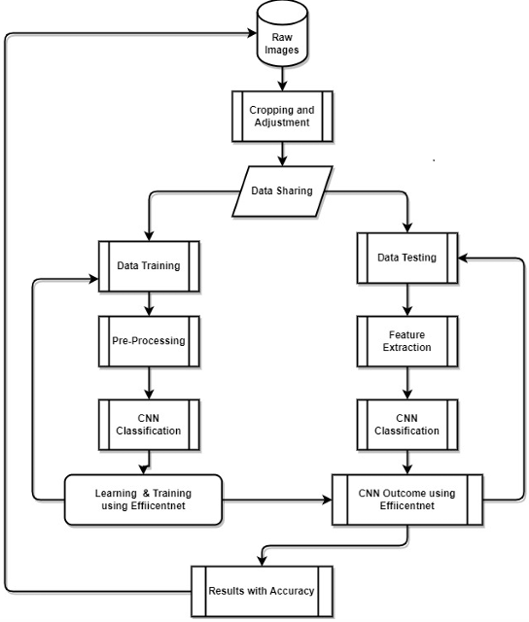
Proposed Recipe Generator contd..
Flow Chart
The flow chart shows the execution flow of the proposed eye disease classification and prediction.
The proposed system is trained on different CNN models.

Slide 19
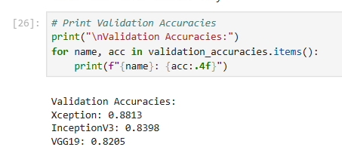
VII. Result and Discussion
Classifier Evaluation: We assessed three classifiers for predicting Eye disease using key performance metrics. The models employed are deep learning models which are Xception, InceptionV3 and VGG19.
Accuracy Evaluation: Accurate predictions are vital. We evaluated the classifiers' accuracy as follows:
Best Model is Xception with an accuracy of 88% on the validation data and 91% on training data.

Slide 20
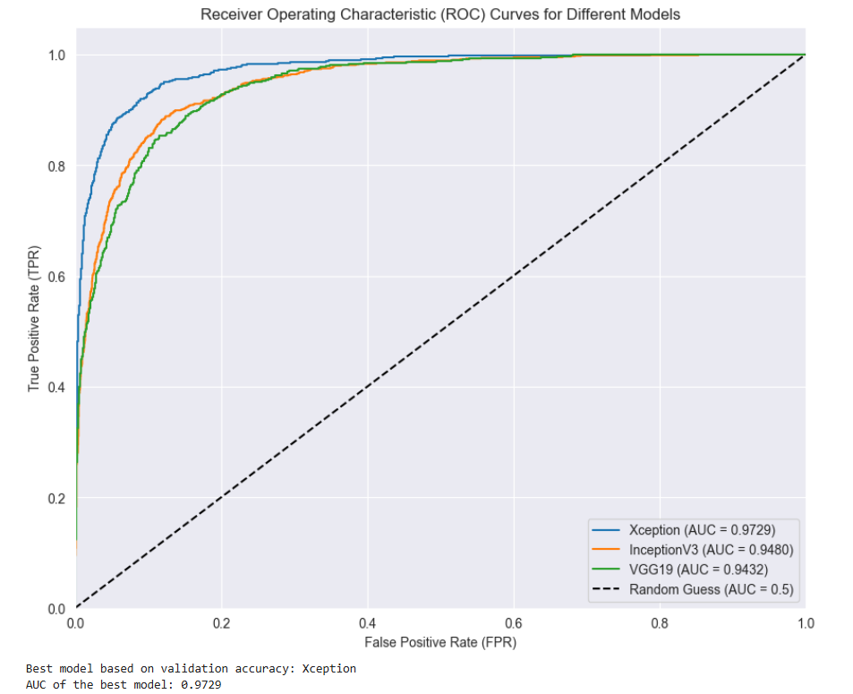
VII. Result and Discussion
ROC Analysis:
The ROC (Receiver Operating Characteristic) curve shows the trade-off between True Positive Rate (TPR) and False Positive Rate (FPR) at different thresholds.
Higher curves indicate better performance (closer to the top-left).
AUC (Area Under Curve) measures overall model performance (higher AUC = better model).
AUC = 0.5 means random guessing, while AUC = 1 is perfect classification.

Slide 21
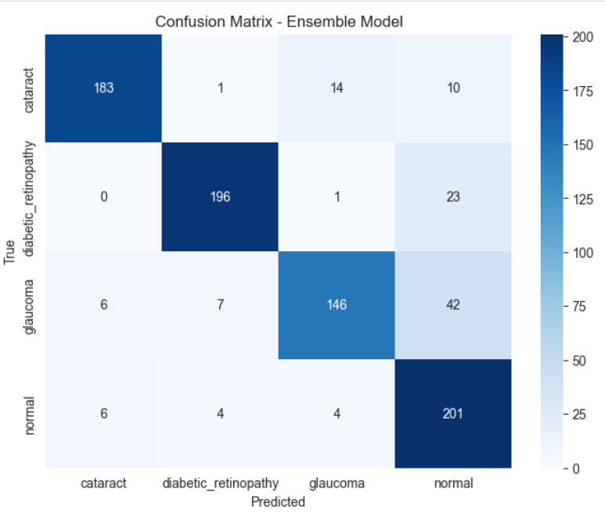
VII. Result and Discussion
Confusion Matrix:
The confusion matrix evaluates an ensemble model for classifying Cataract, Diabetic Retinopathy, Glaucoma, and Normal eye conditions.
The diagonal values represent correct classifications, with Diabetic Retinopathy (196) and Normal (201) performing best. Cataract (183) and Glaucoma (146) show more misclassifications, especially between Glaucoma and Normal (42 cases).

Slide 22
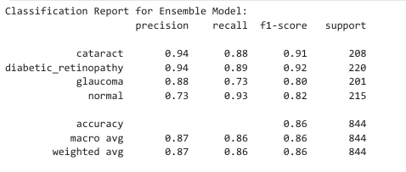
VII. Result and Discussion
The classification report evaluates the ensemble model's performance across four eye disease categories.
Cataract & Diabetic Retinopathy have high precision (0.94) and recall (~0.89), indicating strong prediction performance.
Glaucoma shows lower recall (0.73), meaning some cases are misclassified.
Normal has the lowest precision (0.73) but a high recall (0.93), meaning it detects most normal cases but misclassifies some diseases as normal.

Slide 23
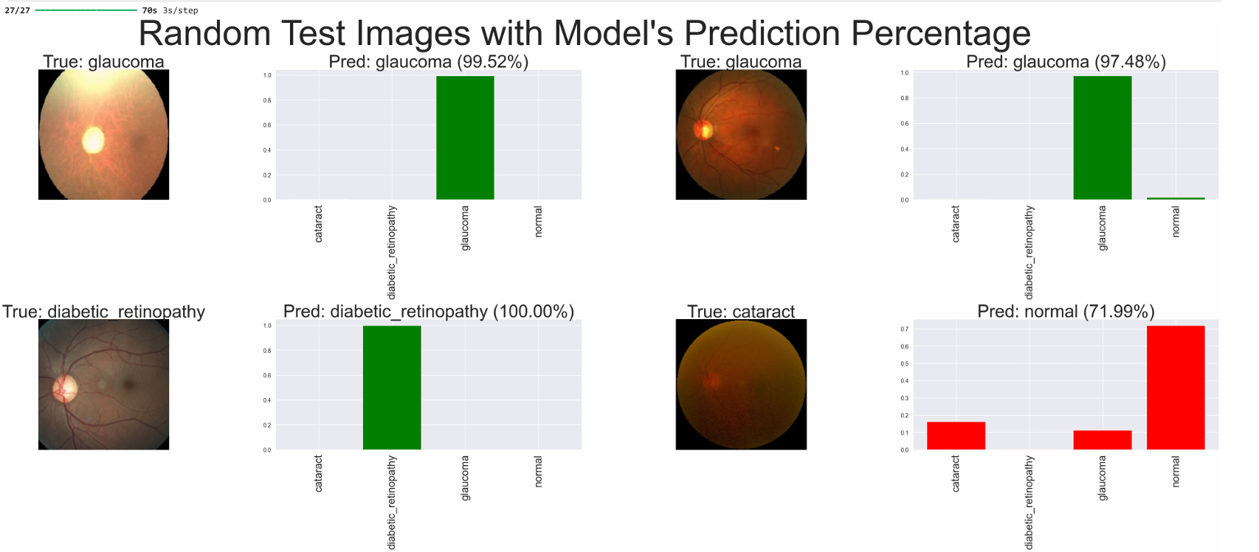
VII. Result and Discussion
Testing the model on random test data.

Slide 24
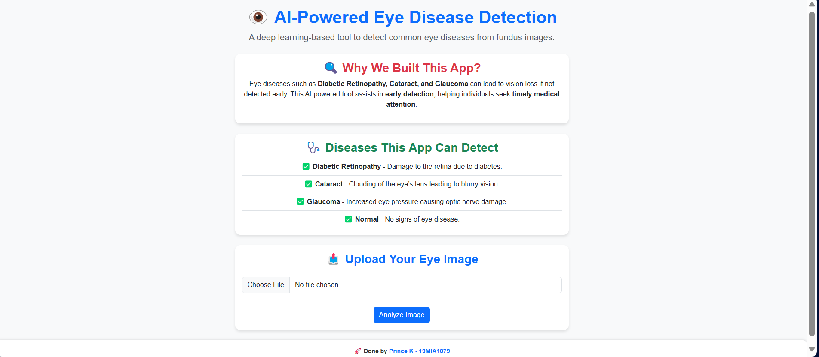
VII. Result and Discussion
Responsive Web Application: Home Page

Slide 25
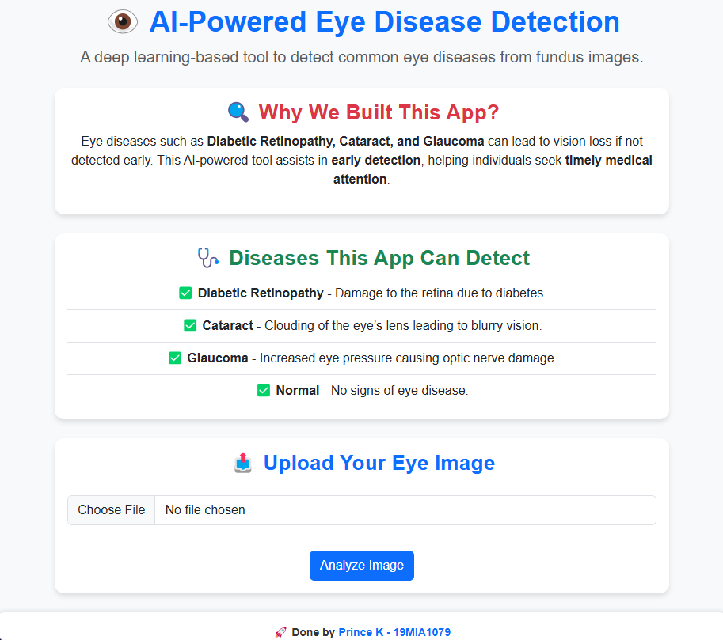
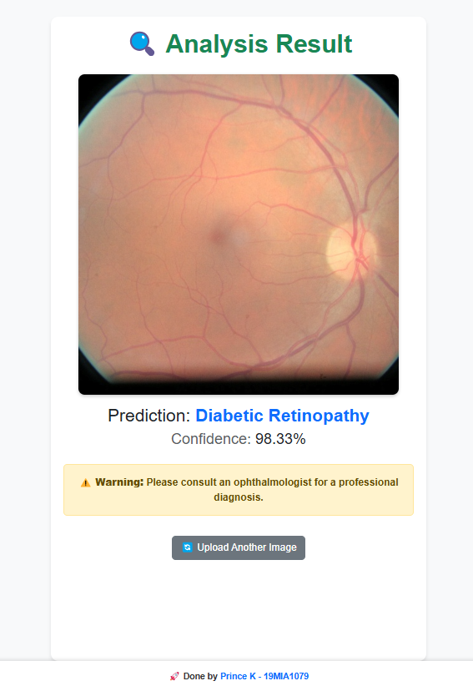
VII. Result and Discussion
Responsive Web Application: Home Page and prediction page

Slide 26

VIII. Conclusion
The ensemble model for retinal disease classification achieves 85% accuracy, demonstrating strong performance in distinguishing between Cataract, Diabetic Retinopathy, Glaucoma, and Normal cases. The model effectively balances precision, recall, and F1-score, showing robustness in real-world applications.
Strengths: High precision for Cataract (0.93) and Diabetic Retinopathy (0.97), indicating reliable positive predictions.
Limitations: Lower recall for Glaucoma (0.74) suggests the model sometimes misclassifies these cases, which needs improvement.

Slide 27

IX. Future work
In the future, We plan to improve the generated recipe by:
Experiment with advanced ensemble methods for better accuracy.
Integrate Grad-CAM for explainability and model interpretability.
Deploy the model as a real-time application for clinical use.
Explore multi-modal learning by incorporating patient history and additional diagnostic data.

Slide 28
X. Guide Approval

Slide 29
XI. References
[1] P. S. Lee, A. K. Misra, and R. S. Gupta, "A Hybrid Approach for Diabetic Retinopathy Classification Using Fungus and Retinal Images," in IEEE Transactions on Medical Imaging, vol. 39, no. 7, pp. 2001-2012, Jul. 2021, doi: 10.1109/TMI.2020.2971989.
[2] S. Sharma, N. Patel, and M. K. Gupta, "Deep Convolutional Neural Networks for Fungal Infection Detection in Retinal Fundus Images," in IEEE Access, vol. 8, pp. 111204-111213, 2020, doi: 10.1109/ACCESS.2020.3000581.
[3] R. S. Sinha, P. G. Singh, and A. N. Kumar, "Fungal Retinopathy Detection Using Fusion of Fundus and Optical Coherence Tomography Images," in IEEE Journal of Biomedical and Health Informatics, vol. 25, no. 8, pp. 2515-2527, Aug. 2021, doi: 10.1109/JBHI.2021.3078324.

Slide 30
XI. References contd..
[7] J. L. Vázquez, P. L. R. de Carvalho, and A. M. Fernandes, "Fundus Image Analysis for Fungal Retinal Disease Classification Using AI Techniques," in Journal of Medical Imaging, vol. 32, no. 10, pp. 104-118, Oct. 2021, doi: 10.1117/1.JMI.32.10.104209.
[8] N. H. Sharma, K. D. Gupta, and P. G. Raghav, "Automated Classification of Fungal Eye Diseases Using Retinal Fundus Images and Convolutional Neural Networks," in IEEE Transactions on Artificial Intelligence, vol. 5, no. 3, pp. 431-440, Mar. 2022, doi: 10.1109/TAI.2021.3061003.
[9] A. R. Rao, P. P. Roy, and B. S. Raghavan, "Fungal Disease Detection in Retinal Images Using Deep Learning Methods: A Comparative Study," in Journal of Ophthalmology, vol. 2022, pp. 1-10, 2022, doi: 10.1155/2022/1026041.

Slide 31
XI. References contd..
[4] M. C. Zhao, L. Q. Yang, and F. K. Tan, "Fungal Retinal Disease Classification Using Hybrid Deep Learning Model for Fundus Image Analysis," in Proceedings of the 2021 IEEE International Conference on Computer Vision, pp. 1456-1463, 2021, doi: 10.1109/ICCV48922.2021.00147.
[5] V. V. Latha, A. S. Roy, and S. Y. Murthy, "Fungal Infection Classification in Retinal Images Using CNNs and Feature Extraction," in Medical Image Analysis, vol. 65, pp. 100-114, Jul. 2020, doi: 10.1016/j.media.2020.101767.
[6] T. Y. Liu, R. M. Choi, and D. K. Patel, "Classification of Fungal Retinopathy Using Multimodal Data and Deep Neural Networks," in IEEE Transactions on Computational Biology and Bioinformatics, vol. 17, no. 12, pp. 2201-2212, Dec. 2020, doi: 10.1109/TCBB.2020.2974578.

Slide 32
Thank You

